Slide 1
The Role of Computer Modelling and Simulation in Medicine. The Paradigm of In Silico Oncology.
Georgios S. Stamatakos
Research Professor
Director, In Silico Oncology and In Silico Medicine Group
Institute of Communication and Computer Systems
School of Electrical and Computer Engineering, National Technical University of Athens (NTUA)
Member of the Board of Trustees, Virtual Physiological Human Institute
Co-Chair, Cancer and In Silico Oncology Task Force, Avicenna Alliance – Association for Predictive Medicine
gestam@central.ntua.gr www.in-silico-oncology.iccs.ntua.gr

Slide 2
Overview
Cancer treatment: a critical research mission
The paradigm of in silico oncology
Landmarks in the development of in silico oncology
Exemplary achievements
Future visions and requirements

Slide 3
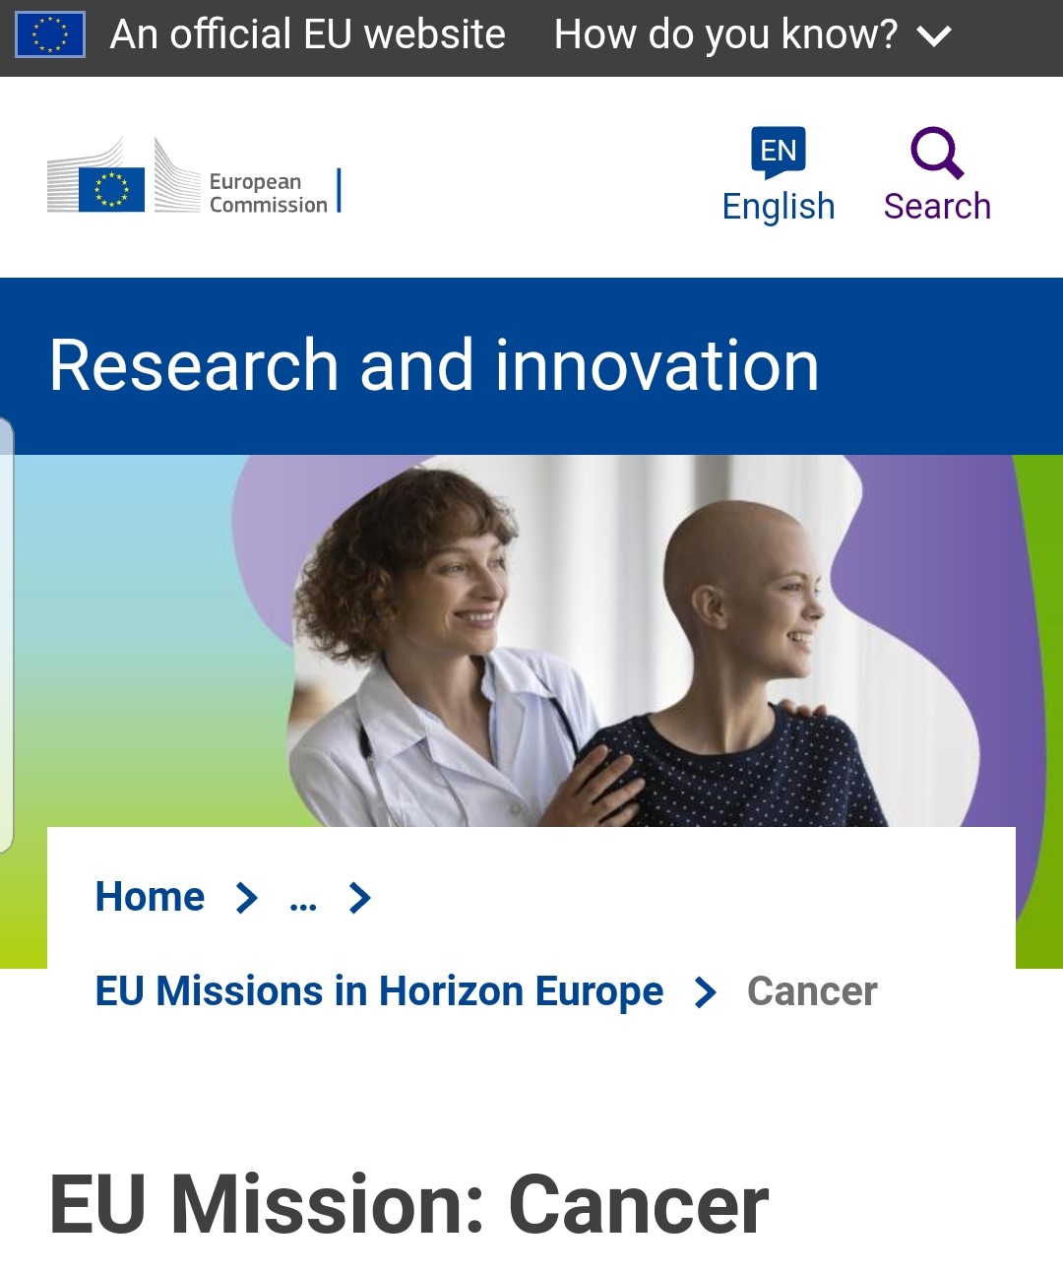
Cancer research: one of the research missions of the European Commission
Each year in Europe (EU), cancers:
Cost more than €100 BN
Kill ~1.2 million people
Scare ~ 2.6 million people diagnosed with cancer
We need a technology jump
https://research-and-innovation.ec.europa.eu/funding/funding-opportunities/funding-programmes-and-open-calls/horizon-europe/eu-missions-horizon-europe/eu-mission-cancer_en

Slide 4
What is in silico oncology ?
In silico medicine (or computational medicine) uses computer modelling and simulation to support
Medical research;
Disease prevention;
Diagnosis, prognosis and patient-specific treatment.
In silico oncology exploits in silico medicine to prevent and cure cancers

Slide 5
In silico oncology uses reliable and scientific computer models
In silico models and digital twins refer to:
(Parts of) the human body (incl. pathologies)
Any interacting drugs or medical devices
Surrounding environment
Patient activities
Models are made of:
Knowledge driven: mechanistic modelling & simulation
Data driven: AI / ML
Advanced statistical modeling
Combinations of the above
All models should be:
Technically and clinically validated
Certified before any regulatory or clinical use
Fully complying with Legal AND Ethical rules

Slide 6
In silico oncology: a 20+ years journey, some landmarks
1st digital twin of in oncology, developed in EU and presented at Massachusetts General Hospital and Harvard Medical School
An early effort to mimic clinical studies on cancer
(precursor of in silico clinical trials)
Completion of the 4 year EU-US research project CHIC on in silico oncology
Birth of in silico oncology
2002
2007
2010
2017
2006
2008
2010
A concrete outline of in silico oncology: a cluster of in silico medical specialties
1st transatlantic Workshop on Multiscale Cancer Modeling, Brussels
ACGT project digital twin (ACGT Oncosimulator), a “world first” for EC

Slide 7
Cancers are diverse;
so are in silico oncology models and digital twins
Cancer types addressed
Cancer treatments addressed
Nephroblastoma (WT)
Acute Lymphoblastic Leukemia (ALL)
Breast Cancer
Lung Cancer (NSCLC)
Cervix Cancer
Prostate Cancer
Glioblastoma (GBM)
Response of normal tissues to Radiotherapy
Etc.
No Treatment (Free Tumour Growth)
Chemotherapy
Radiotherapy
Hormonotherapy
Immunotherapy
Targeted Molecular Therapies (Anti-angiogenic Therapy)
Combined Therapies
Etc
In Silico Oncology and In Silico Medicine Group, National Technical University of Athens in collaboration with numerous research and clinical centres worldwide continuously create and improve advanced computer models to help fighting a wide range of cancer types.

Slide 8
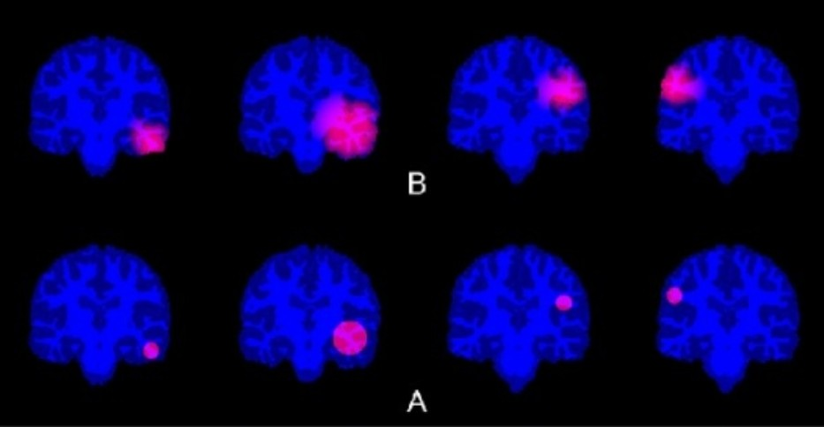
Simulating glioblastoma tumour growth and invasion into the brain can help optimizing radiotherapy treatment
Depending on the initial location of the tumour within the brain (panel A), the tumour will grow and invade the surrounding normal brain tissue in a different way (panel B).
In silico oncology models predict spatiotemporal tumour evolution.
Glioblastomas can grow 1.4 percent in a single day!
Cancer informatics 02/2017; 16(16):1-16., DOI:10.1177/1176935116684824

Slide 9
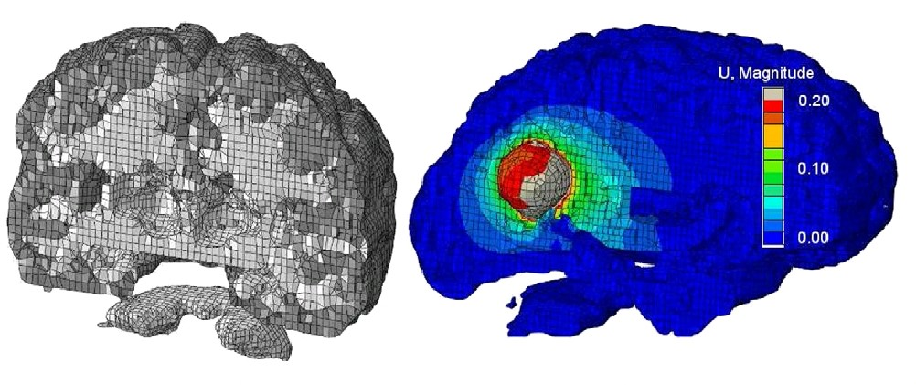
Coupling biological and mechanical simulation of a glioblastoma brain tumour growth and invasion can lead to more refined and reliable predictions
Progress in Biophysics and Molecular Biology 07/2011; 107(1):193-9., DOI:10.1016/j.pbiomolbio.2011.06.007

Slide 10
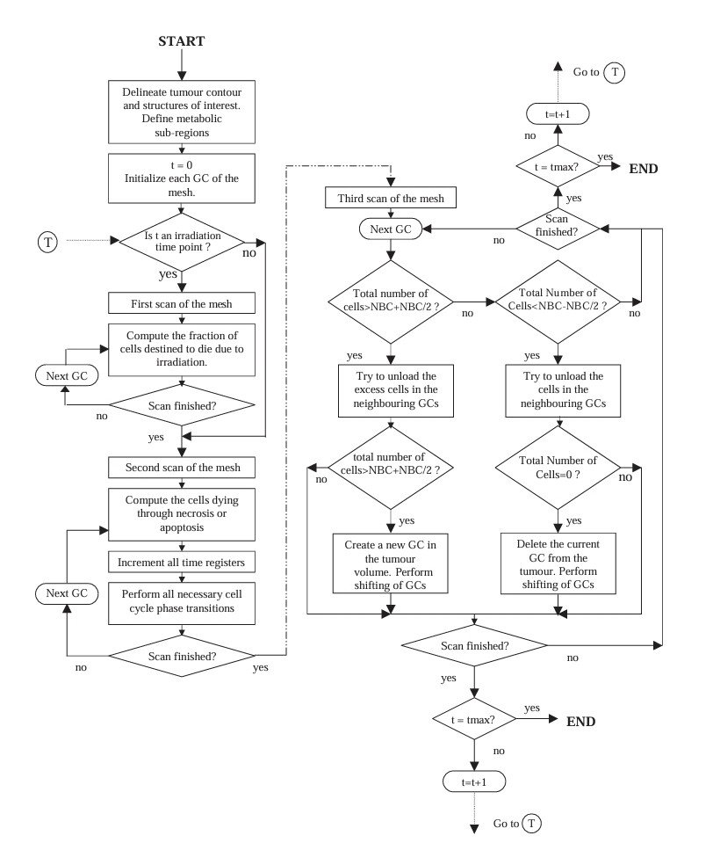
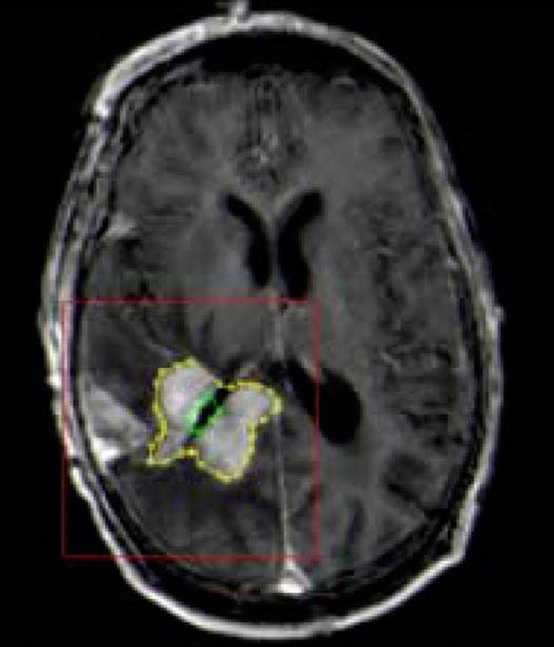
Beyond predicting tumour evolution,
models can suggest personalized treatment
Simulating the response of a clinical brain tumour to various radiotherapy schemes
Selection of the most appropriate personalized schedule for a given patient
Journal of Theoretical Biology 10/2004; 230(1):1-20., DOI:10.1016/j.jtbi.2004.03.024
Numerical simulation protocol predicting the evolution of a brain tumour through in silico oncology.

Slide 11
In silico oncology provides assistance to the doctor and the patient
Reliably predicting the response of a clinical tumour to different radiotherapeutic schemes in space and time.
Helping the doctor and the patient to better understand existing treatment options and select the best one.
AHF_48
Accelereated Hyperfractionated scheme with total absorbed dose = 48 Gy
HF81_6
Hyperfractionated scheme with total absorbed dose = 81.6 Gy
Video “ACGT project: The Oncosimulator,” YouTube, https://www.youtube.com/watch?v=fdKHl4ecfwg
G S Stamatakos et. al, The British Journal of Radiology 2006 79:941, pp.389-400, https://doi.org/10.1259/bjr/30604050

Slide 12
Predicting and understanding the tumour growth to better fight it
“Travelling” within a clinical tumour at a given time point
for two different radiotherapeutic schemes
Provides an overview of the changing internal cellular structure of the tumour
AHF_48_clipped
HF81_6_clipped
Video “ACGT project: The Oncosimulator,” YouTube, https://www.youtube.com/watch?v=fdKHl4ecfwg
G S Stamatakos et. al, The British Journal of Radiology 2006 79:941, pp.389-400, https://doi.org/10.1259/bjr/30604050

Slide 13
The in silico oncology paradigm of nephroblastoma pediatric tumour:
a clinical perspective
Nephroblastoma or Wilms tumour: a rare abdominal tumour occurring in young children.
The distinction from other tumour entities at diagnosis is essential to start the correct treatment.
Initial diagnosis primarily based on imaging: Wilms tumours should not undergo an open biopsy before starting neoadjuvant chemotherapy
Challenge
In silico Oncology can improve the reliability of image assessment and predict treatment response and outcome.
Large datasets of corresponding imaging, clinical and molecular data → develop / evaluate tools for automated image analysis.
A decentralized approach ensures data protection and security as data will not leave their source hospitals.
Tool for radiologic assessment of tumours: of great value for initial treatment decisions.
Solution
Prediction of the response to treatment from initial MRI imaging and eventually serum molecular data through in silico oncology →
desperately needed
better treatment stratifications.
Despite a high survival rate (90% in patients with Wilms tumour), no improved outcome with conventional measures in past 10 to 20 years.
~ 10% of children with this tumour will die.
This approach = a proof of principle by expanding developed models to other clinical centres / other tumour types
Benefits
Prof. Norbert Graf, MD, University of Saarland, Dept. for Pediatric Oncology and Hematology, Homburg, Germany

Slide 14
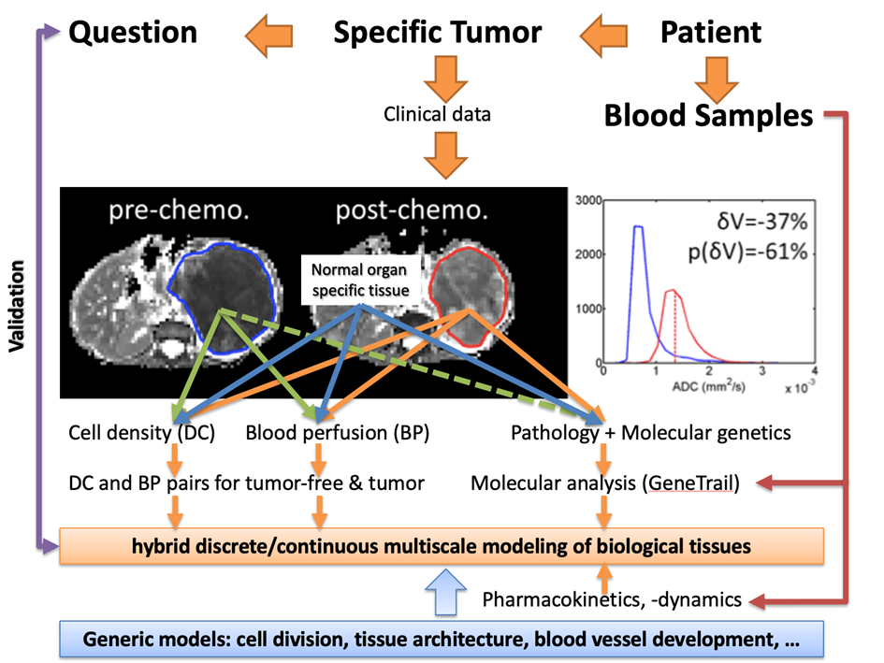
Data to be collected and used by a nephroblastoma digital twin

Slide 15
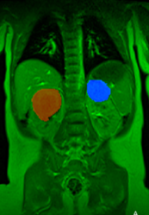
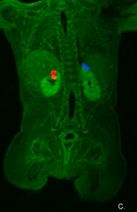
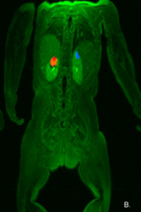
Actual response of a bilateral pediatric nephroblastoma tumour treated with chemotherapy (SIOP 2001/GPOH)
1st Time-point
2nd Time-point
3rd Time-point
Images are not in scale
DVR=94%
DVL=95%
DVR=90%
DVL=89%
R
L
R
L
R
L
Data provided by Prof. Norbert Graf, MD, USAAR, Germany

Slide 16
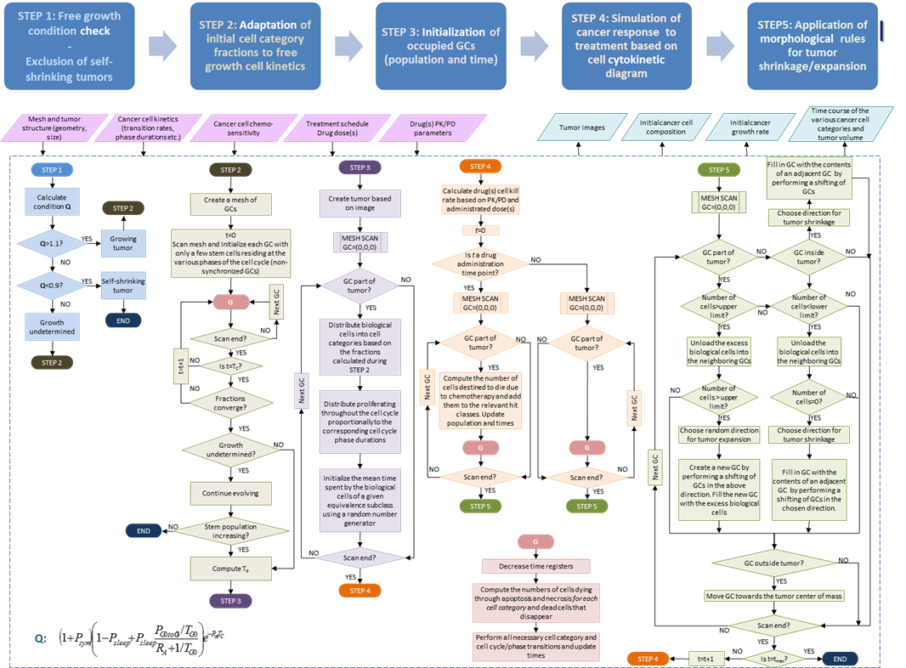
A mechanistic multiscale model of the response
of a solid tumour to chemotherapy
PLoS ONE 03/2011; 6(3):e17594., DOI:10.1371/journal.pone.0017594
Computers in Biology and Medicine 10/2012; 42(11):1064-78., DOI:10.1016/j.compbiomed.2012.08.008

Slide 18
Prediction of the response of the previous clinical bilateral nephroblastoma tumour to the specific chemotherapeutic scheme administered
1st time-point
NTUA Nephroblastoma Oncosimulator
1st time-point
2nd time-point
PLoS ONE 03/2011; 6(3):e17594., DOI:10.1371/journal.pone.0017594
Computers in Biology and Medicine 10/2012; 42(11):1064-78., DOI:10.1016/j.compbiomed.2012.08.008
2nd time-point
3rd time-point
3rd time-point
Tumour on the Right Kidney
Tumour on the Left KIdney

Slide 19
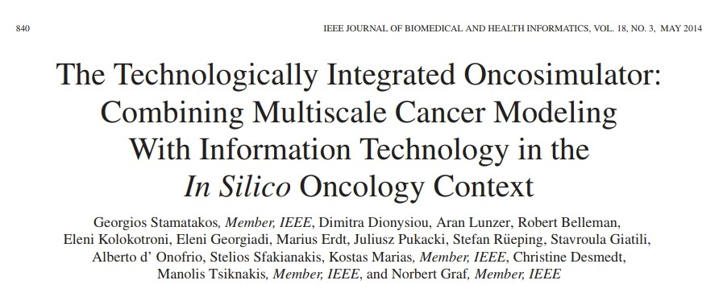
An advanced digital twin for the exemplary cases of
nephroblastoma and breast cancer

Slide 20
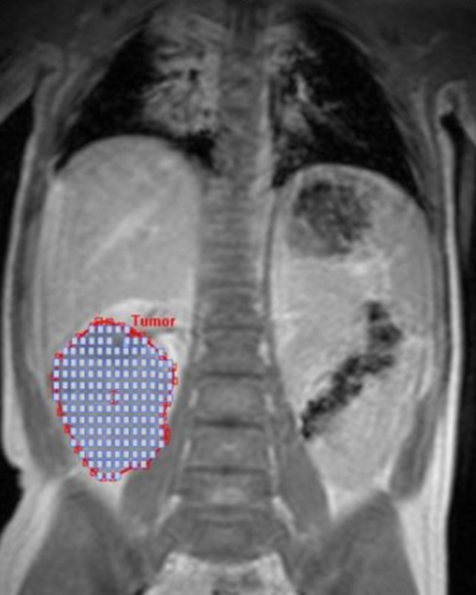
Semi-automatic data collection and processing can accelerate the efficiency of the Oncosimulator digital twin
Segmentation and discretization of the nephroblastoma tumour using a cubic mesh.
A simplified Onsosimulator functioning workflow
from the clinical perspective

Slide 21
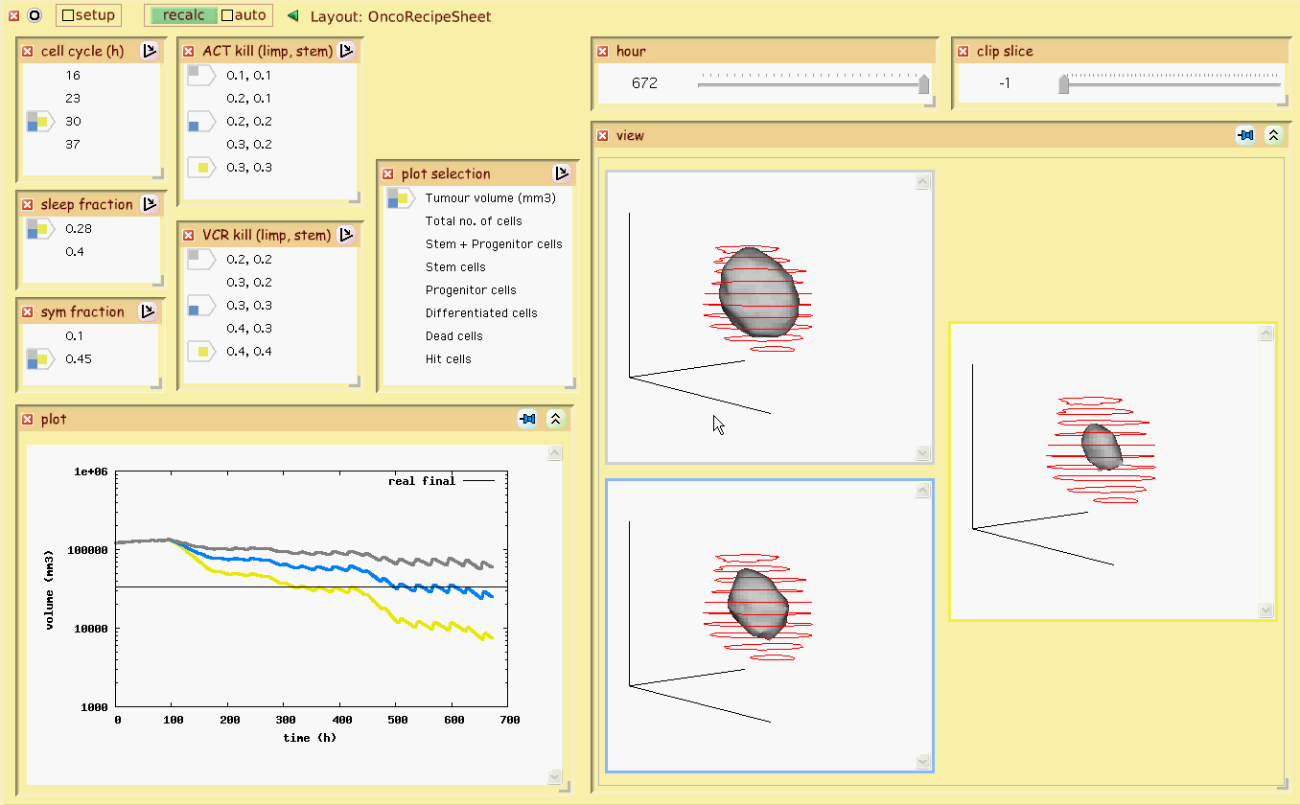
Advanced visualization features offer numerous possibilities for the optimal perception of the digital twin predictions

Slide 22
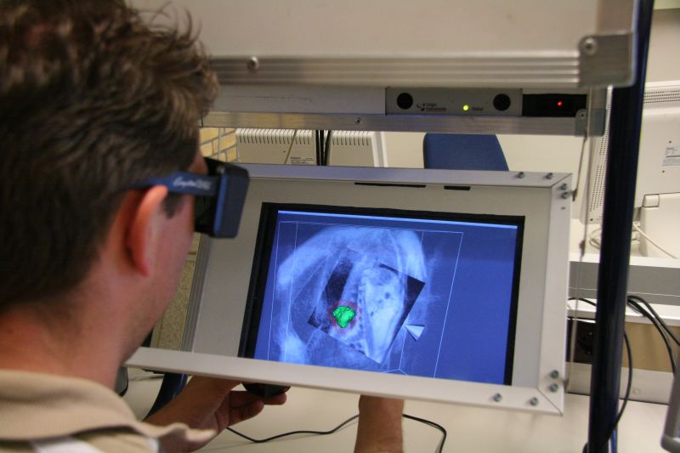
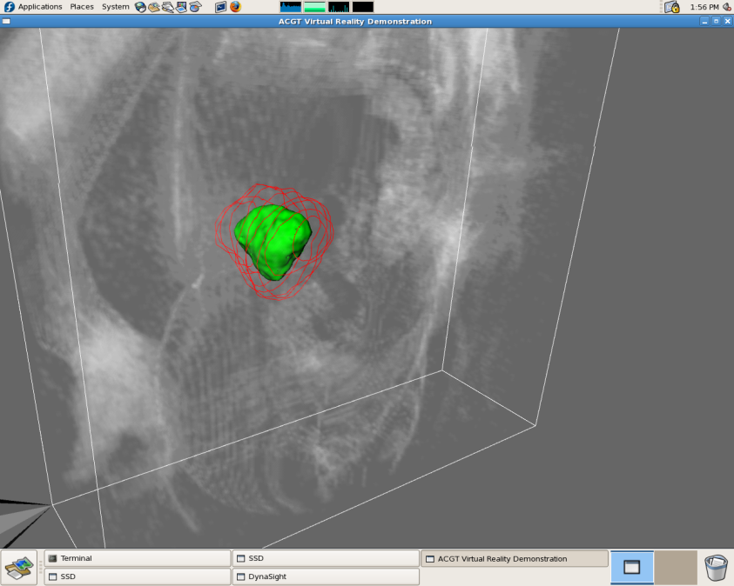
Virtual reality offers unparalleled possibilities for
spatial visualization of the digital twin predictions

Slide 23
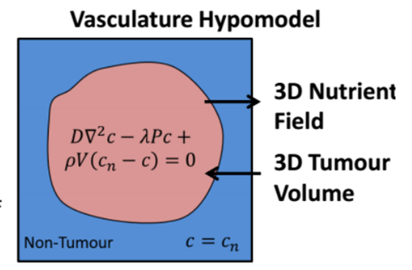
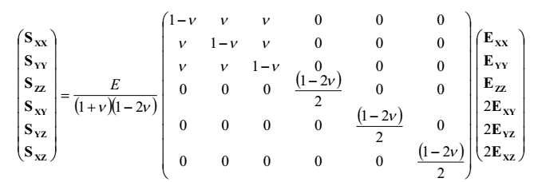
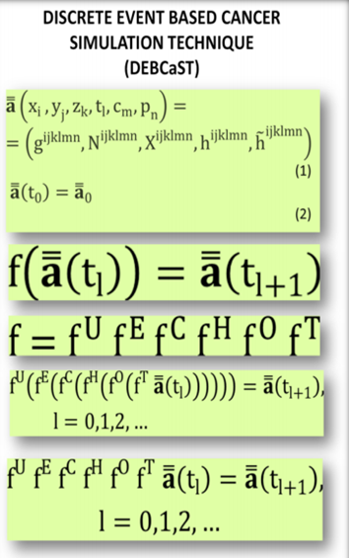
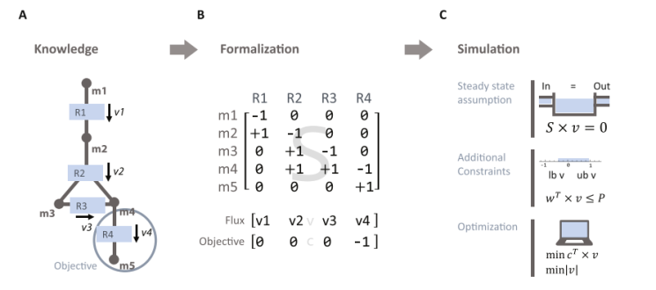
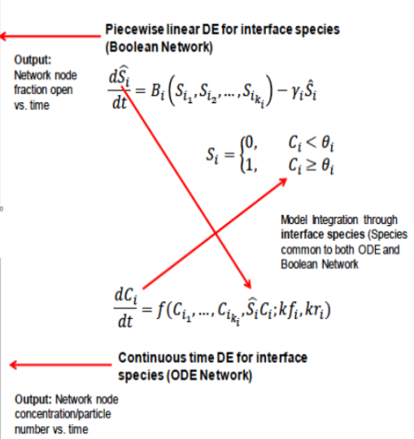
CLINICAL TUMOUR HYPERMODELLING: Tumour growth and treatment response hypermodel and mathematics hidden behind each constituent hypomodel
NEOANGIOGENESIS HYPOMODEL
Oxford University
CORE TUMOUR GROWTH & TREATMENT RESPONSE HYPOMODEL
National Technical University of Athens (ICCS)
BIOMECHANICAL HYPOMODEL
University of Bern
The CHIC EU-US Project
http://www.chic-vph.eu/
Clinical Therapeutics 08/2017; 39(8):e107-e108., DOI:10.1016/j.clinthera.2017.05.333
METABOLIC HYPOMODEL
Foundation for Research and Technology – Hellas
MOLECULAR HYPOMODEL
University of Pennsylvania

Slide 24
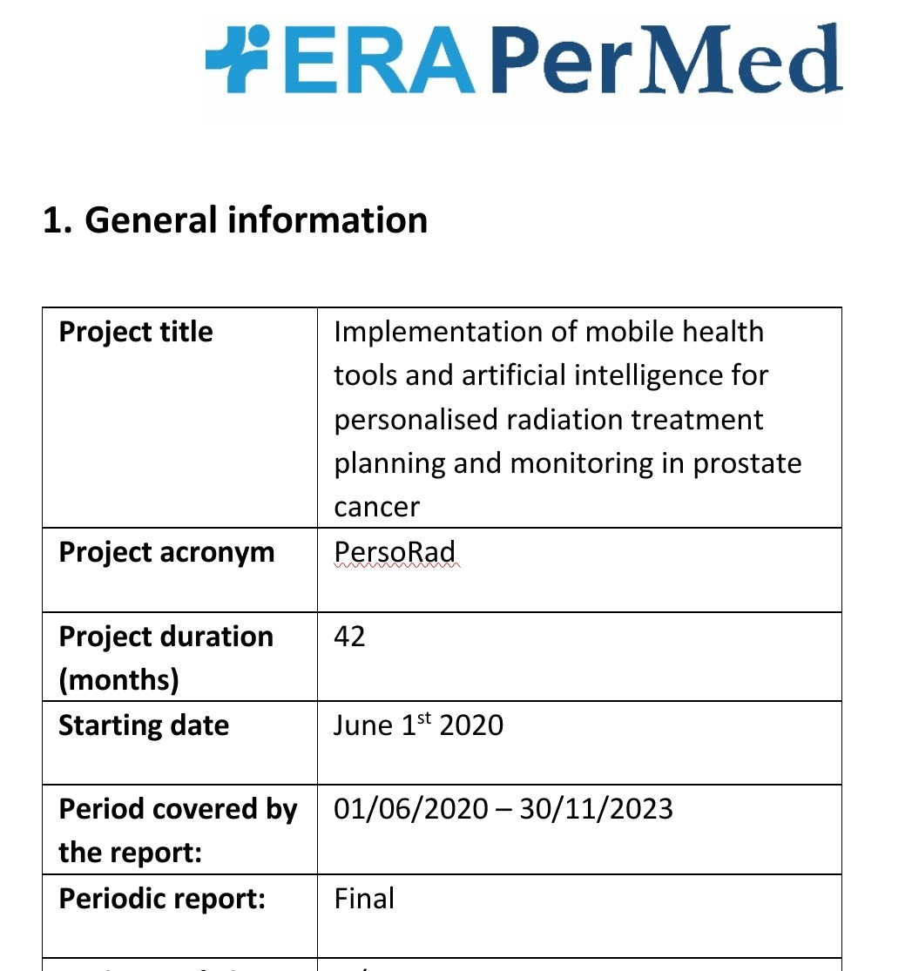
Artificial intelligence as one of the pillars of in silico oncology
Clinical data and clinical guidance was provided by Prof. Stefaan Gool, Catholic University of Leuven, Belgium (at the time), currently Medical Director - Translational Oncology, IMMUN-ONKOLOGISCHES ZENTRUM KÖLN, Cologne, Germany
PersoRad has been coordinated by the University of Freiburg, Medical Centre, Department of Radiation Oncology, Germany

Slide 25
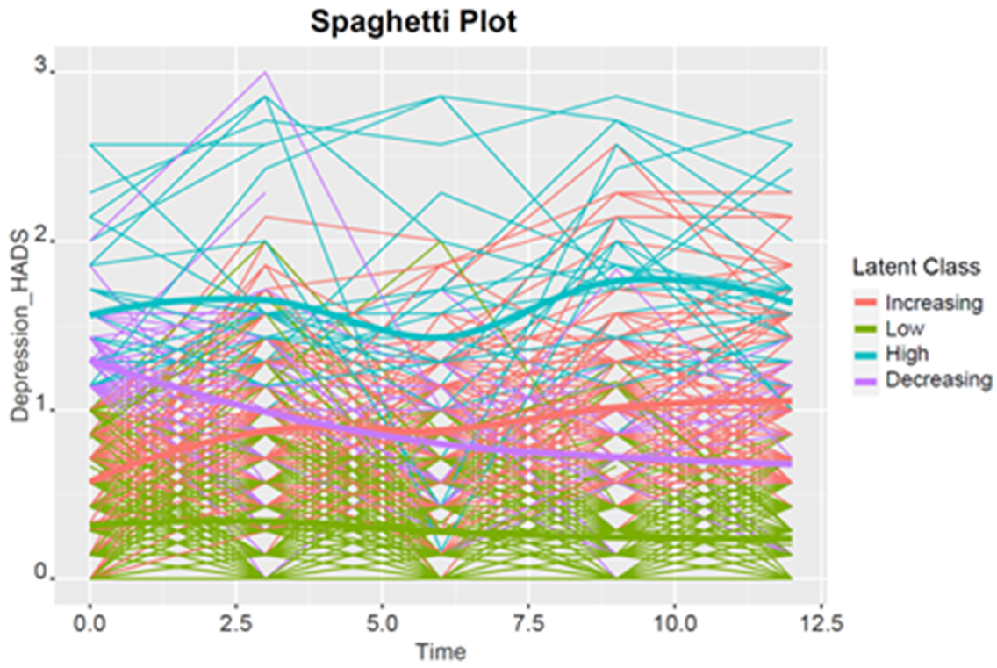
In Silico Psycho-Oncology
Cancer patients face many types of psychosocial problems affecting their quality of life for many years.
Psychological symptoms, coping mechanisms, negative affect: strong predictors for breast cancer patiens well-being (EC funded project BOUNCE).
It is important to offer supportive interventions for patients who are at risk for psychological symptoms or decreased quality of life in the future.
Machine learning algorithms and AI techniques can help professionals to find these patients at risk.
Psycho-oncology is an important part of modern cancer care.
(P. Poikonen, Helsinki University Hospital )
(E. Kolokotroni et al., Abstract Book, Virtual Physiological Human Conference VPH2022, Porto, Portugal, 6-9 Sep. 2022, p. 112.

Slide 26
Future visions and requirements
BROADER GOALS
Accelerate, optimize and personalize cancer treatment through the development, clinical validation, certification and clinical translation of in silico methods
SPECIFIC TECHNICAL GOALS AND REQUIREMENTS
Develop clinically driven and overseen digital twins of tumour growth and tumour and organism response to cancer treatment interventions.
Ensure trustworthiness, explainability, robustness, stability and good quality of component interconnection for all underying mechanistic and/or AI and/or hybrid models.
Technically and clinically validate cancer digital twins and in silico clinical trials through formal clinical studies.
Translate cancer digital twins into clinical practice , following regulatory certification
Monitor and evaluate the clinical use of certified cancer digital twins and further exploit the latter for in silico clinical trials and broader clinical research
Engage patients and the broader public into the procedure of acceptance of in silico methods

Slide 27
ACKNOWLEDGMENTS
The contributions of all persons and organizations to the work presented or referred to in this lecture or to relevant supportive actions are duly acknowledged. An indicative list of collaborators, supporters and organizations is provided below. However, due to the very large number of collaborators and supporters (hundreds) across the globe as well as inevitable space limitations, in no way should this list be considered exhaustive.
RESEARCHERS FROM IN SILICO ONCOLOGY AND IN SILICO MEDICINE GROUP (PAST AND PRESENT) , NATIONAL TECHNICAL UNIVERSITY OF ATHENS (NTUA)
Eleni Kolokotroni, Dimitra Dionysiou, Vassilis Antipas, Eleni Georgiadi, Stavroula Giatili, Eleftherios Ouzounoglou, Katerina Argyri, Nikolaos Christodoulou, Christos Kyroudis, Nikolaos Tousert, Vaggelis Chatzidimitriou, Foteini Panagiotidou, Stamatia Tsampa, Evangelia Zacharaki, Fay Misichroni, Markos Antonopoulos, Oraianthi Fiste, Maria Kalogeropoulou, Nikoletta Sofra, Nikolaos Mouravlianski, Konstantinos Rizavas, Michail Kozamanis, numerous past diploma/MSc thesis students and Nikolaos Uzunoglu
RESEARCHERS AND SUPPORTERS OUTSIDE IN SILICO ONCOLOGY AND IN SILICO MEDICINE GROUP, NATIONAL TECHNICAL UNIVERSITY OF ATHENS (This is an incomplete list)
Norbert Graf, Konstantinos Marias, Metin Akay, David Ingram, Ilias Iakovidis, Eckart Meese, Rainer Bohle, Nikolaos Zamboglou, Dimos Baltas, Werner Duechting, Thomas Deisboeck, Daniel Gallahan, Roger Dale, Georgios Pissakas, Marcel Meyerheim, Werner Audretsch, Martin Stanulla, Olle Björk, Vangelis Sakkalis, Elena Tsiporkova, Vassilios Kouloulias, Stefaan van Gool, Caterina Guiot, Feng Dong, Piotr Czauderna, Aran Lunzer, Robert Belleman, P. Melis, Juliusz Pukacki, Paula Poikonen Saksela, Ketti Mazzocco, Ruth Pat-Horenczyk, A. Folarin, Chariklia Tziraki, J. Sabczynski, Ravi Radhakrishnan, Kyriacos Hatzaras, Marco Viceconti, Francesca Buffa, Manolis Tsiknakis, Dido Yova, Stelios Sfakianakis, Marius Erdt, Alberto d’ Onofrio, Peter Coveney, Debora Testi, Giovanni Erbacci, Jakko Aarnio, Georgios Potamias, Stefanos Gouvras, Geogios Manikis, Anca Bucur, Nikolaus Forgo, Konstantina Nikita, Dimitra Kaklamani, Theodora Varvarigou, Philippe Büchler, Christian May, J. Zepp, Domenico Gabriele, Brecht Claerhout, Myrsini Makropoulou, Haridimos Kondylakis, Daniel Abler, Kari Tanderup, Berta Sousa, Christine Desmedt, Helen Byrne, Caterina Guiot, Farhad Rikhtegar, Ioannis Karatzanis, Corrina Hahn, Albino J. Oliveira-Maia, Isabel Manica, Elias Glytsis, Ioannis Roumeliotis, Fatima Cardoso, Evangelos Karademas, Stefen Renisch, Dimitrios Soudris, Luca Toldo, Panagiotis Simos, Elisabetta Munzone, R. Ronchaud, Gretta Pettini, Virginia Sanchini, Johanna Mattson, Carl Blomqvist, A. Hoppe, Astrid Franz, Laura Adamoli, Andreas Persidis, C. Veith, Panagiotis Frangos, Ilan Roziner, Ilias Sachpazidis, Anca-Ligia Grosu, James Lyons Weiler, Lien Solie, M. Reyes, Imme Petersen, R. Kollek, George Fountzilas, Eleni Fountzila, Paris Kosmidis, Thanos Kosmidis, David Johnson, Steve McKeever, A. Marioli, Shifeng Wang, Xin Zhou, Kim Taylor, Eleni Natsi, I. Lykourentzou, K. Kyriaki, Yuzuru Tanaka, M. Synodinou, Ragnar Bergström, Gordon Clapworthy, Baoquan Liu, Emmanuel Protonotarios, Georgios Kostakos, Jose Manuel Garcia, Maria Angeles Pérez Ansón, Simon Spohn, Lisbet Geris, Martina Contin, Roberta Maggi, Constantinos Zamboglou, Meletios Athanasios Dimopoulos, Maria Moschovi. Thierry Marchal, Stelios Kympouropoulos
Special thanks are due to the Hellenic State, the General Secretariat for Research and Innovation, Greece, the European Commission, EU, the European Parliament, EU, the National Cancer Institute – National Institutes of Health, USA, the Virtual Physiological Human Institute and the Avicenna Alliance - Association for Predictive Medicine for providing funding and/or support. The academic support and encouragement of ICCS-NTUA, ECE-NTUA and NTUA and their recent heads N. Uzunoglu, S. Tzafestas, Y. Vassiliou, I. Psarras [ICCS], D. Tsamakis, N. Koziris, P. Tsanakas [ECE] and A. Boudouvis, I, Chatzigeorgiou [NTUA] are duly acknowledged.

Slide 28
ACKNOWLEDGEMENTS - Medical schools and clinical centres with which In Silico Oncology and In Silico Medicine Group, ICCS, ECE, National Technical University of Athens, has collaborated so far
Medical School and Hospital, University of Saarland, Homburg, Germany
Harvard Medical School, Boston, USA
Massachusetts General Hospital, Boston, USA
Medical School Imperial College London, London, UK
Medical School of Hannover (MHH) and Hospital, Hannover, Germany
Department of Oncology, University of Oxford, Oxford, UK
Medical School and Hospital, University of Helsinki, Helsinki, Finland
Medical School and Hospital, University of Aarhus, Aarchus, Denmark
Medical School and Hospital, University of Freiburg, Freiburg, Germany
School of Social Work and Social Welfare, The Hebrew University of Jerusalem, Jerusalem, Israel
European Institute of Oncology, Milan, Italy
Klinikun Offenbach, Offenbach, Germany
Champalimaud Foundation, Lisbon, Portugal
Institut des Tumeurs Jules Bordet, Brussels, Belgium
Medical School, National and Kapodistrian University of Athens, Athens, Greece
Medical School, University of Crete, Heraklion, Greece
Saint Savvas Hospital, Athens, Greece
Saint Sophia Children’s Hospital, Athens, Greece
Metaxa Hospital, Piraeus, Greece
HYGEIA Medical Centre, Athens, Greece
German Oncology Centre, Limassol, Cyprus
Medical School and Hospital, Catholic University of Leuven, Leuven, Belgium
Candiolo Cancer Institute- FPO-IRCCS, Department of Radiology, Candiolo, Turin, Italy
Città della Salute e della Scienza Hospital, University of Torino, Turin, Italy
IOZK – Immuno-Oncological Centre Cologne, Cologne, Germany
Faculty of Medicine, University of Kiel and University Hospital, Kiel, Germany

Slide 29
Thank you Ευχαριστώ

